Slide 1
NCIA Integration Points
Grid Interface
ISPY Interface
Data Basket Interface

Slide 2
Grid Interface
The primary external interface.
  Allows access to all PUBLIC metadata and DICOM images in NCIA repository.
Data Service plus some “analytical” operations to make image retrieval more convenient.
  retrieveDicomData(cqlQuery)
  retrieveDicomDataByPatientIds(java.lang.String[] patientIds)
  retrieveDicomDataBySeriesUIDs(java.lang.String[] seriesInstanceUids)
  retrieveDicomDataByStudyUIDs(java.lang.String[] studyInstanceUids)

Slide 3
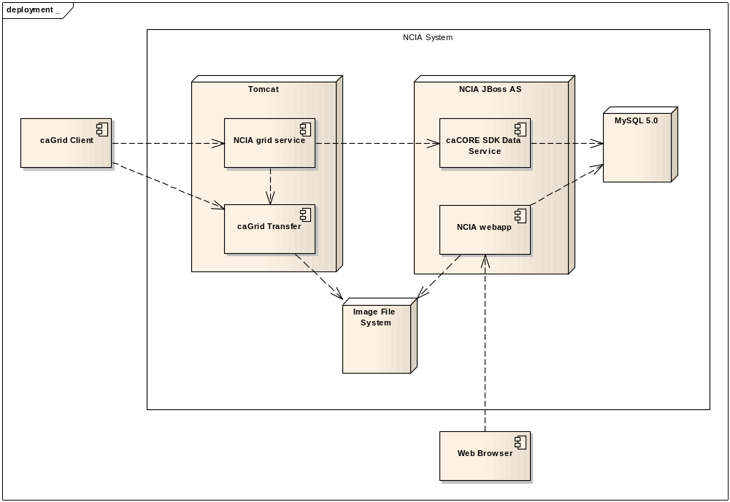
Grid Architecture

Slide 4
What artifacts are accessible?
The usual metadata is available through the Data Service interface by way of CQL.
Through the use of caGrid Transfer, DICOM images are also available.
The DICOM images can be retrieved by way of CQL or through analytical operations.
Zip file of DICOM images organized similarly to Data Basket download.

Slide 5
Performance
The analytical operations are much more optimized than the generic CQL operation.
Problems with larger datasets because of Apache httpd proxy at NCICB. Any request that takes longer than 5 minutes to process will timeout.
  Especially a problem when passing in lots of patient identifiers at one time.

Slide 6
Private Collections
Private data will not be available over the grid until implementation of a “secure grid” interface.
Possibly in release 4.3.

Slide 7
ISPY interface
Specially constructed page to show two images side by side and allow download of the actual DICOM images.
Available through HTTP GET to a special URL: /ncia/referencedImages
Request parameters determine which images are shown:
  Image[1,2]StudyInstanceUid
  image[1,2]SeriesInstanceUid
  image[1,2]ImageSopInstanceUid
Some other parameters to customize presentation (labels for images).
Private collections are available through this interface.

Slide 8
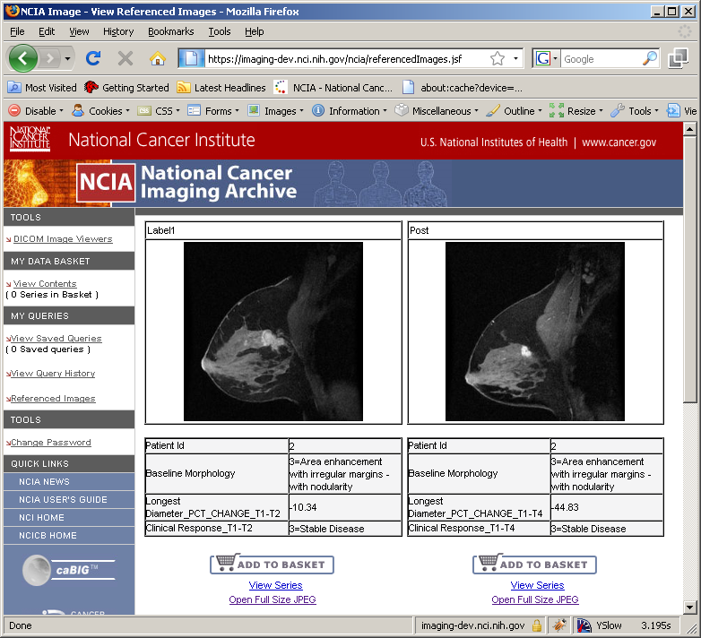
ISPY Screenshot

Slide 9
Data Basket Interface
Forthcoming interface to allow an HTTP POST to the data basket page “within” the application.
Client passes patient, study and series identifiers to populate data basket with.
Developed on behalf of caIntegrator2.
Technical challenges presented by current architecture: JSF, “statefulness”.
  ISPY interface sort of “hardcoded”.
  Attempting a more general approach for Data Basket. Might open up more opportunities for integration.

